Slide 1
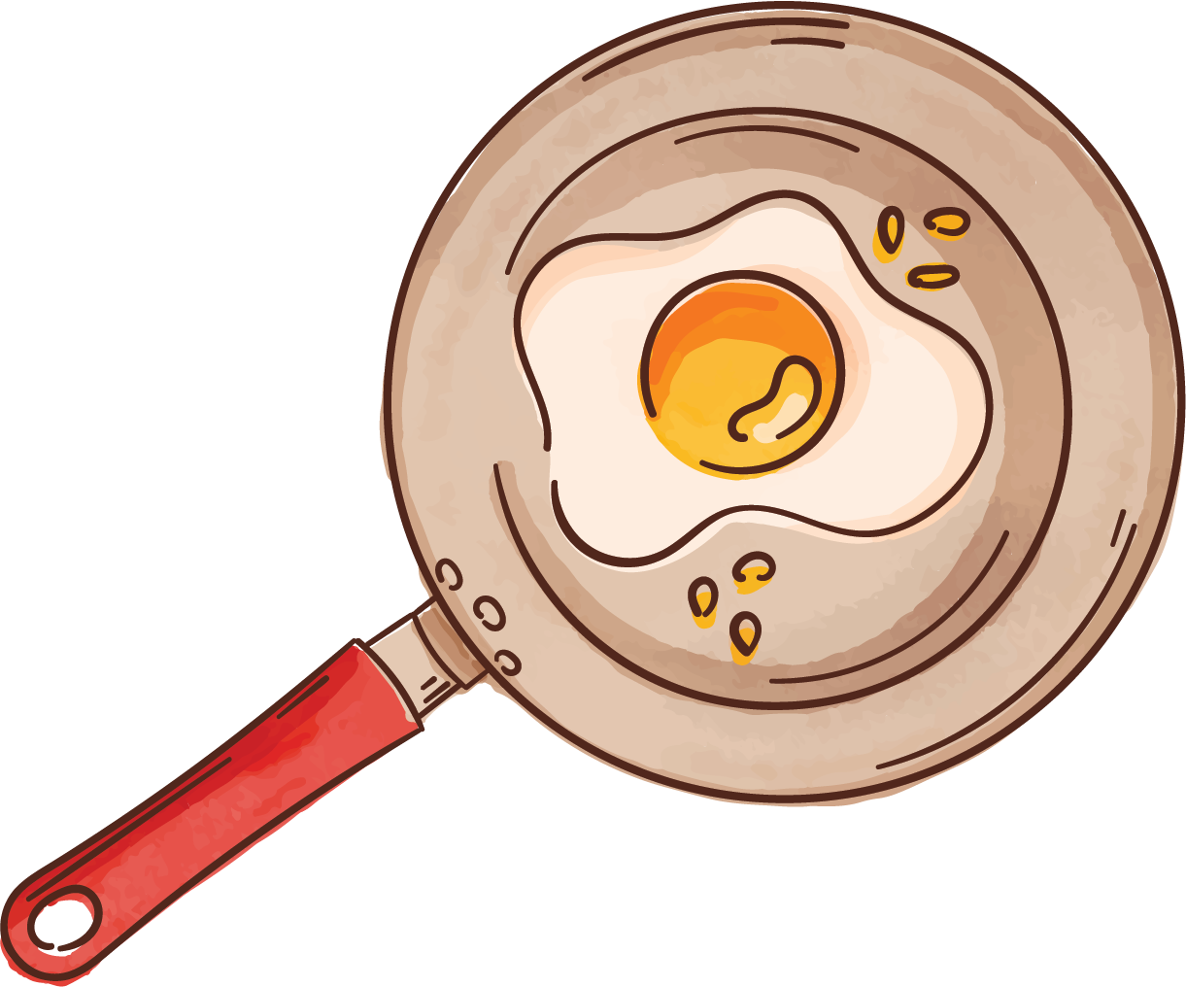

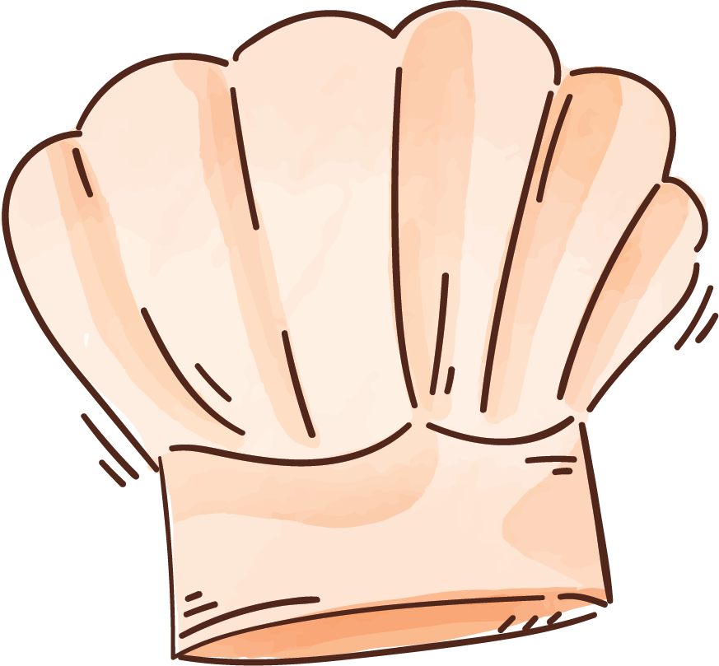




Dishcovery
What do i want to cook today?
User Centered Design, Autumn 2025 Marina Köhli Henri Kangas Hans-Andrea Danuser

Slide 2
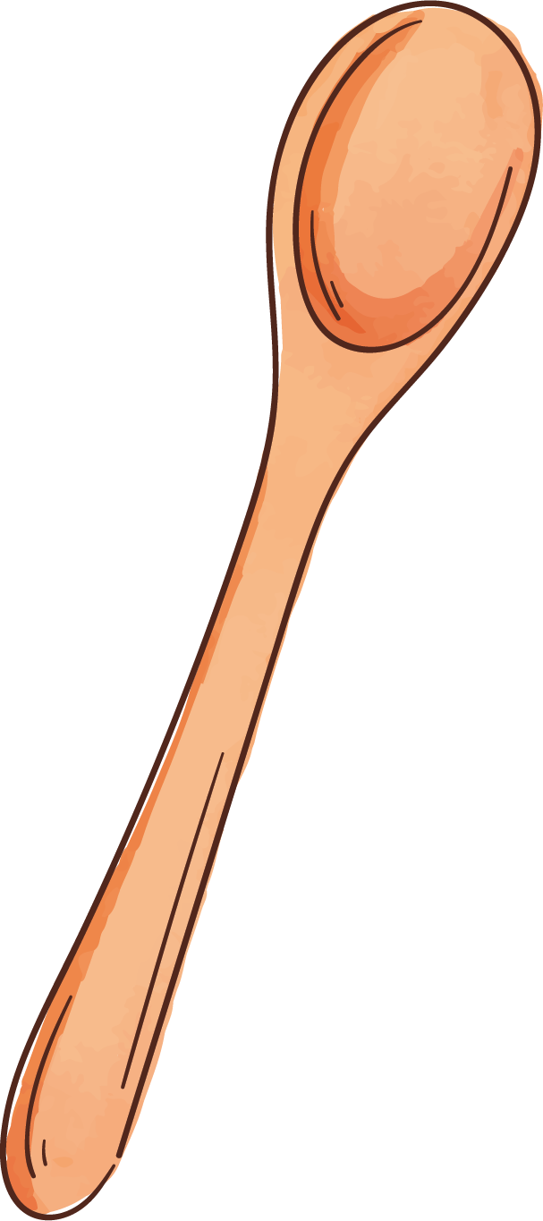
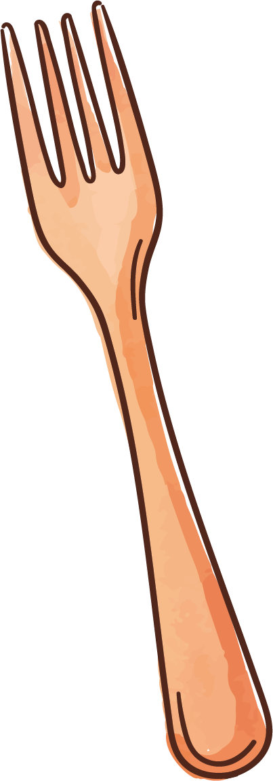
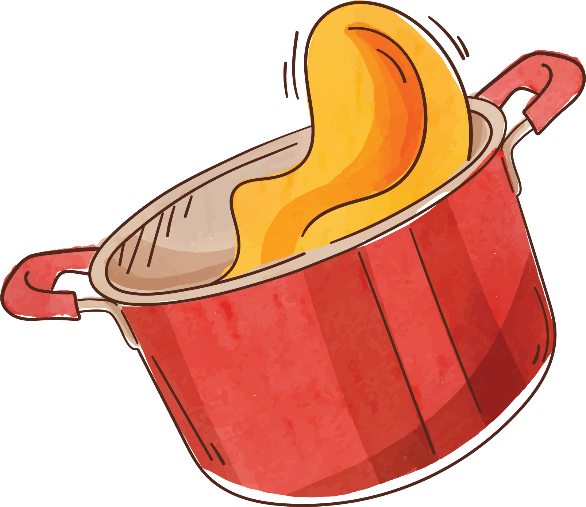

Introduction
Dishcovery is a comprehensive mobile cooking application that is designed as a personal assistant to make cooking, planning and storing recipes more efficient.
The goal is to make an interactive figma model which simulates how the actual application works in practise.

Slide 3
Features
Major
Database recipe search
Personal recipe collection
AI chatbot assistant
Minor
Recipe sharing
Seasonal daily recipe suggestion
Dark mode
Default search option (allergy filter, etc)
Advanced search features

Slide 4
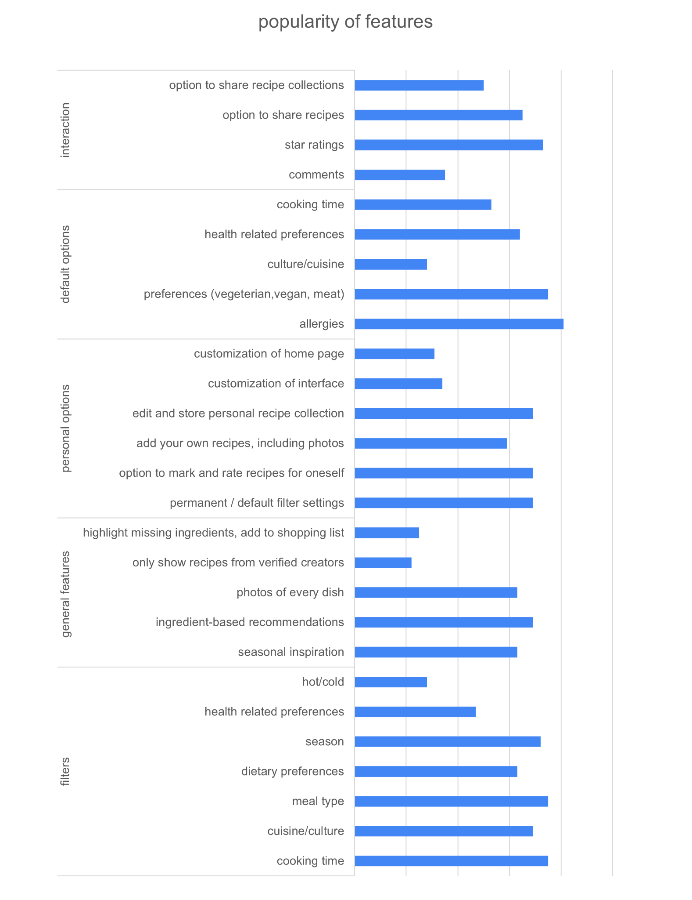
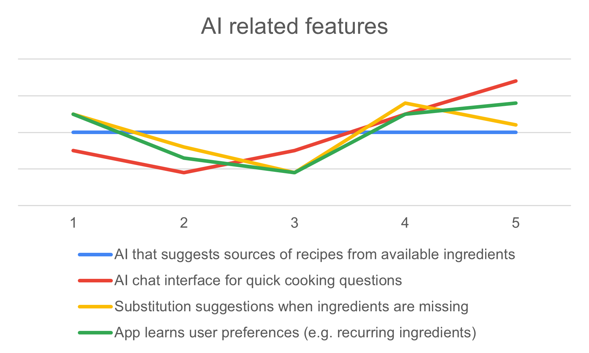
Exploratory study
Interviews (n=4): generated features
basis for the questionnaire
Questionnaire (n=32):
age range: 10-81
more information on the features

Slide 5
Personas
Robert
Profile: 61y, lawyer, swimmer, has a wife and two adult children
Cooking type: cooking is his passion, likes to serve his family and friends extravagant and elaborate menus; does not feel comfortable with AI
How he would use the app: store recipes, plan menus, search recipes for specific ingredients he’s trying out
Carla
Profile: 22y, studies geography, works in a bar, likes yoga, lives in a shared flat with her best friends, family: her parents and a brother
Cooking type: cooks out of necessity, prefers other activities. Moved out 2 years ago and is still figuring out how to balance household tasks. Uses AI often.
How she would use the app: share recipes with her flatmates, get cooking tips

Slide 6
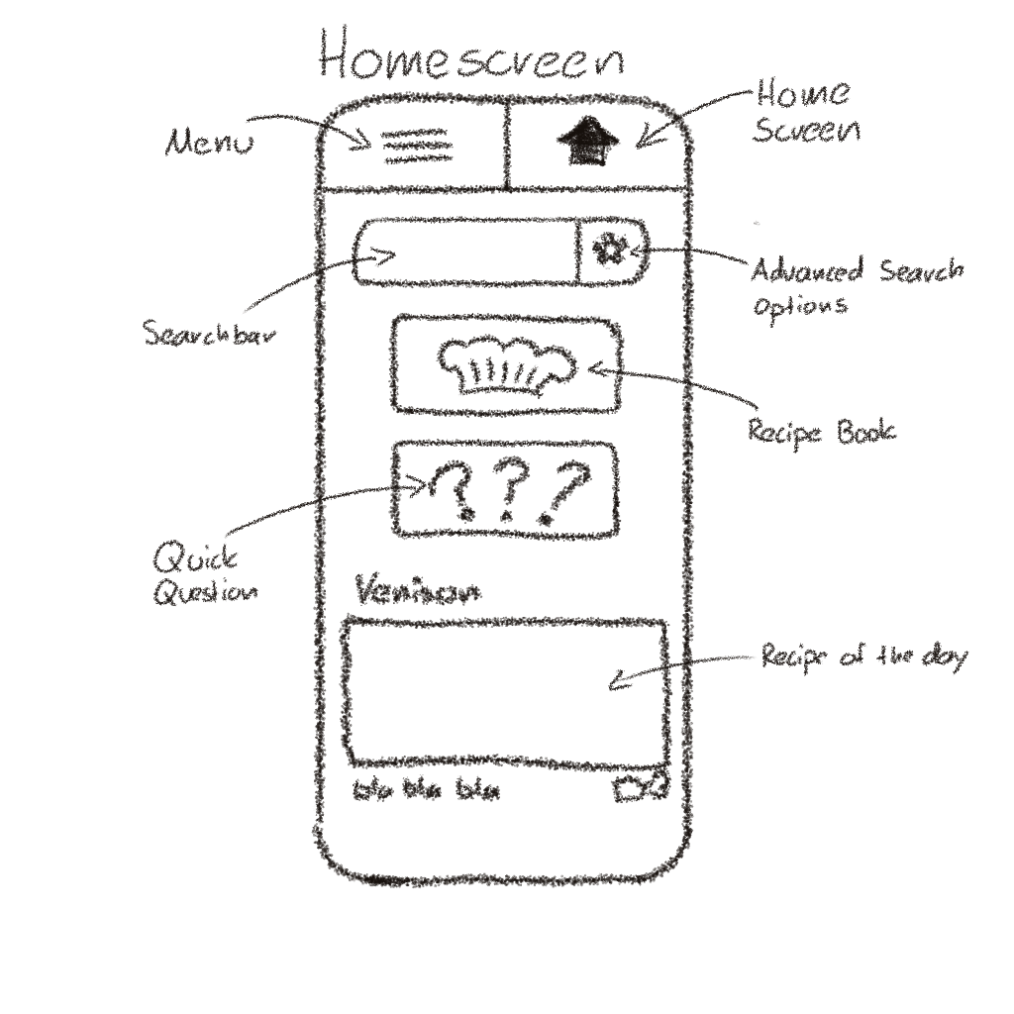
Prototype Sketch

Slide 7
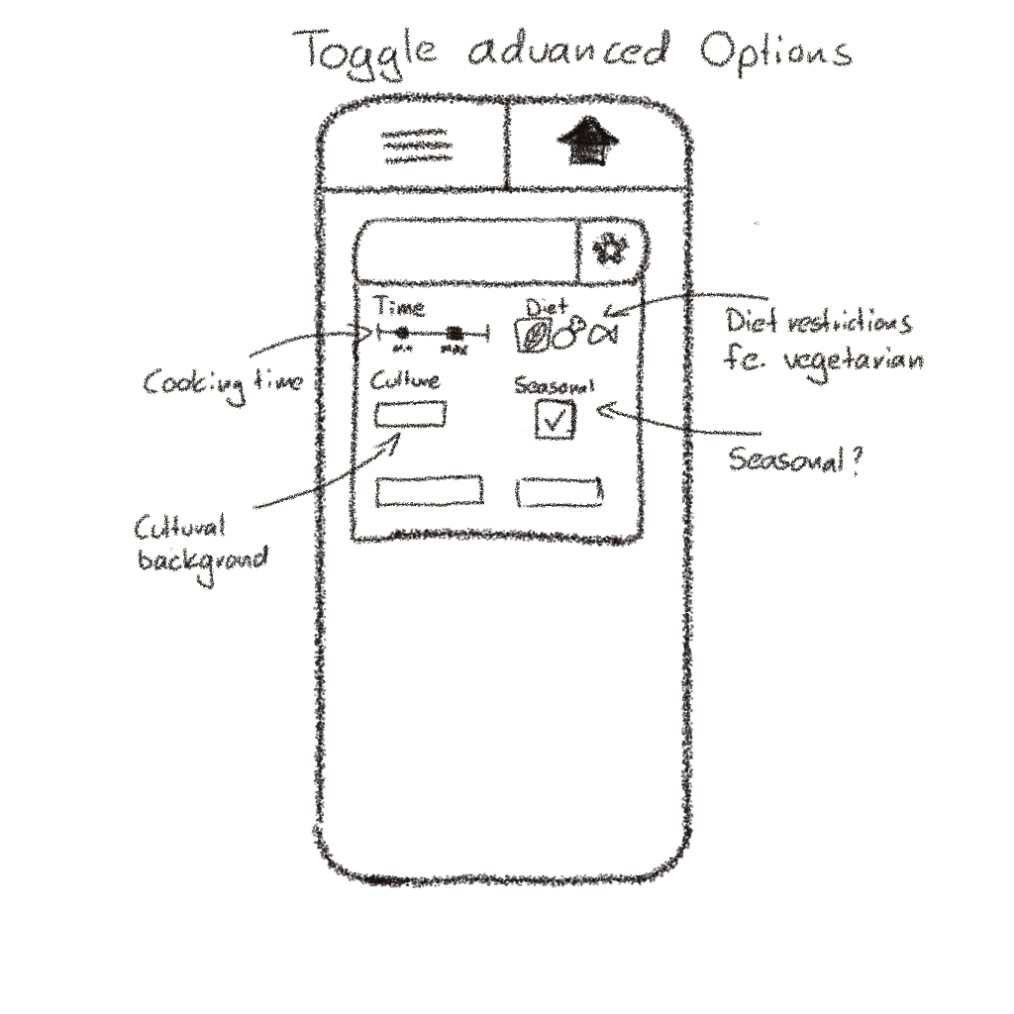
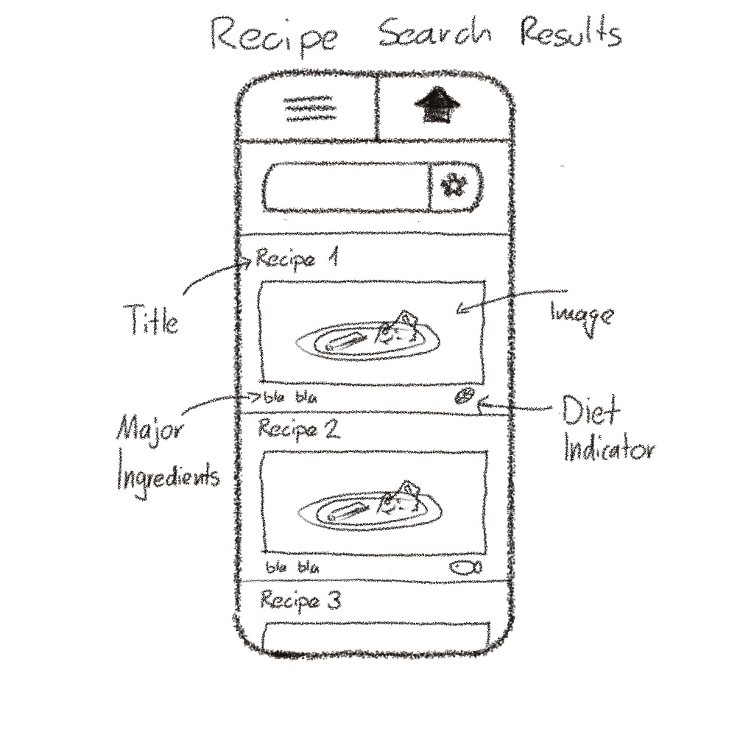
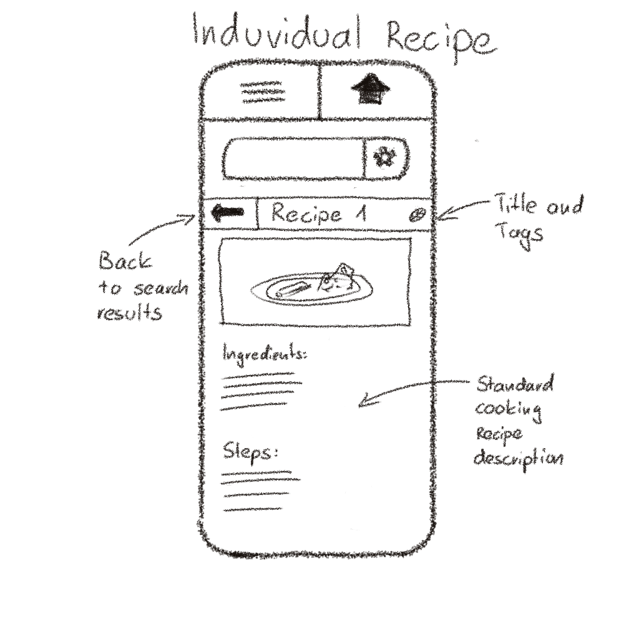
Prototype, Searching/Results

Slide 8
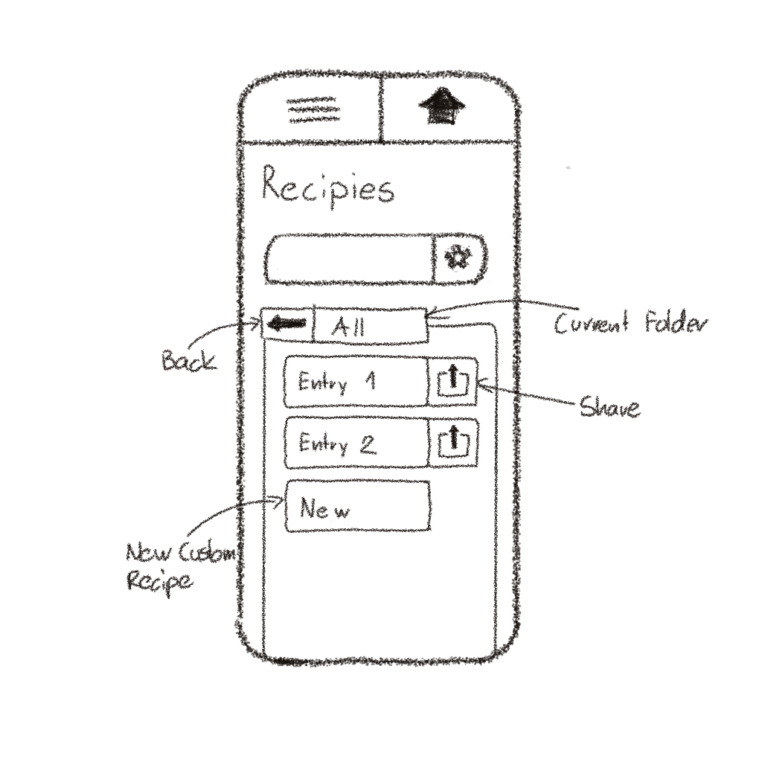
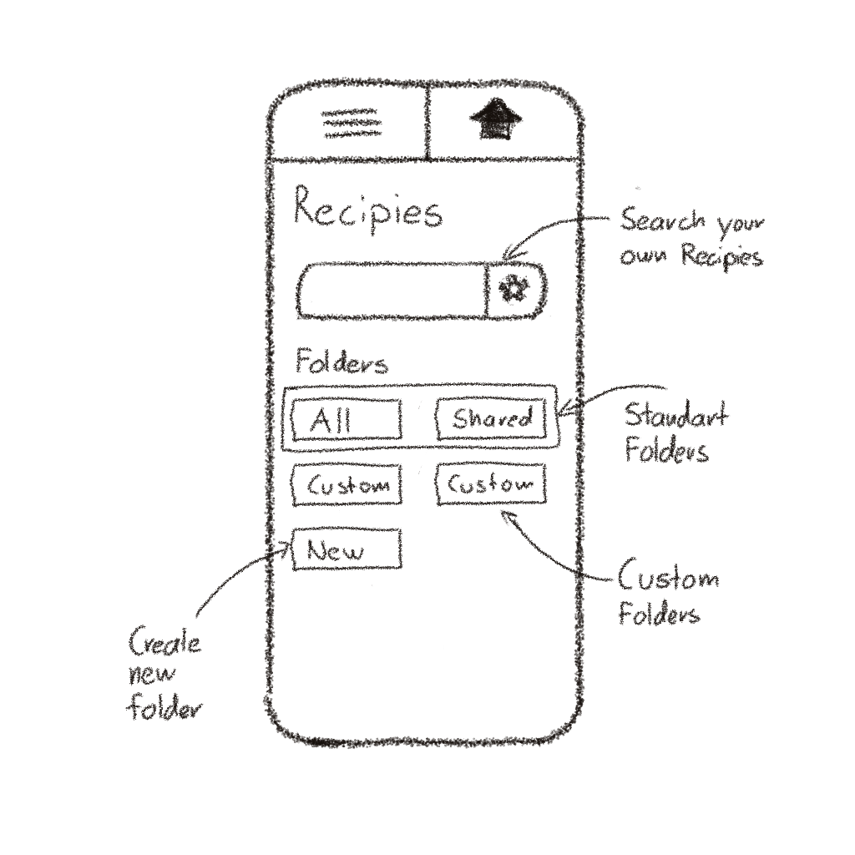
Prototype, Recipe Book

Slide 9
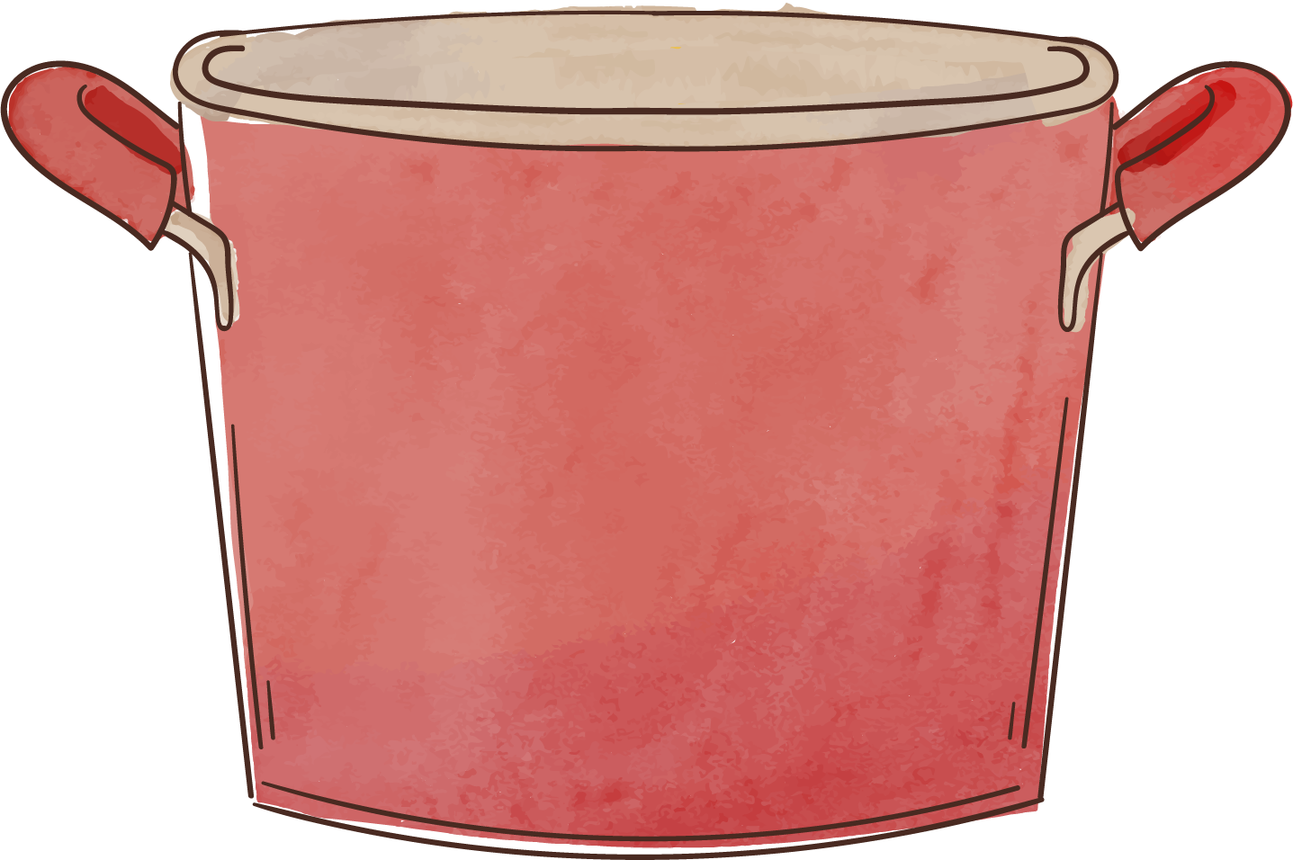
Questions?

